Slide 1
Installation of Arduino Pro Micro Software

Slide 2
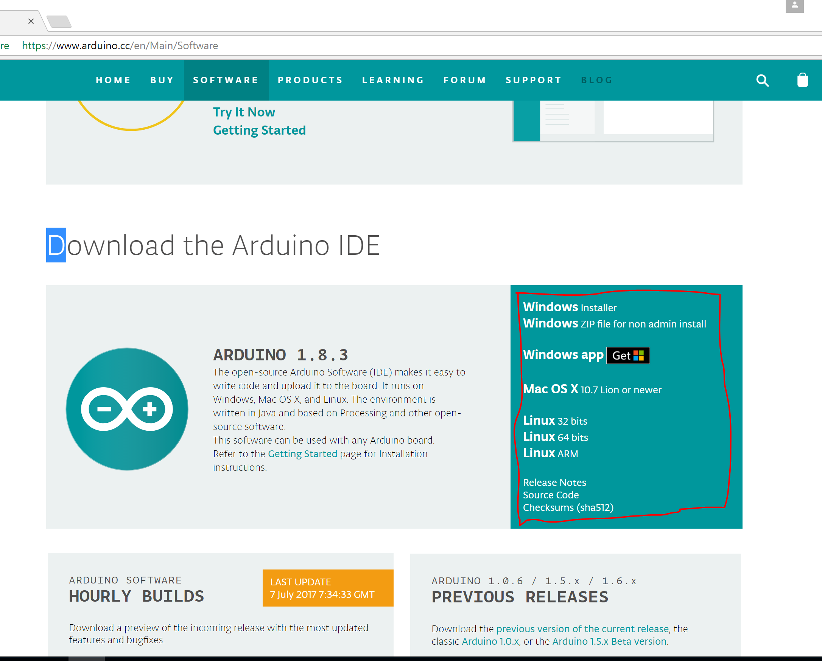
Step 1:
Enter the link below:
https://www.arduino.cc/en/Main/Software
Scroll down to the section “Download the Arduino IDE”
Select the installation file based on your laptop operating system
Run/Unzip the installation zip file

Slide 3
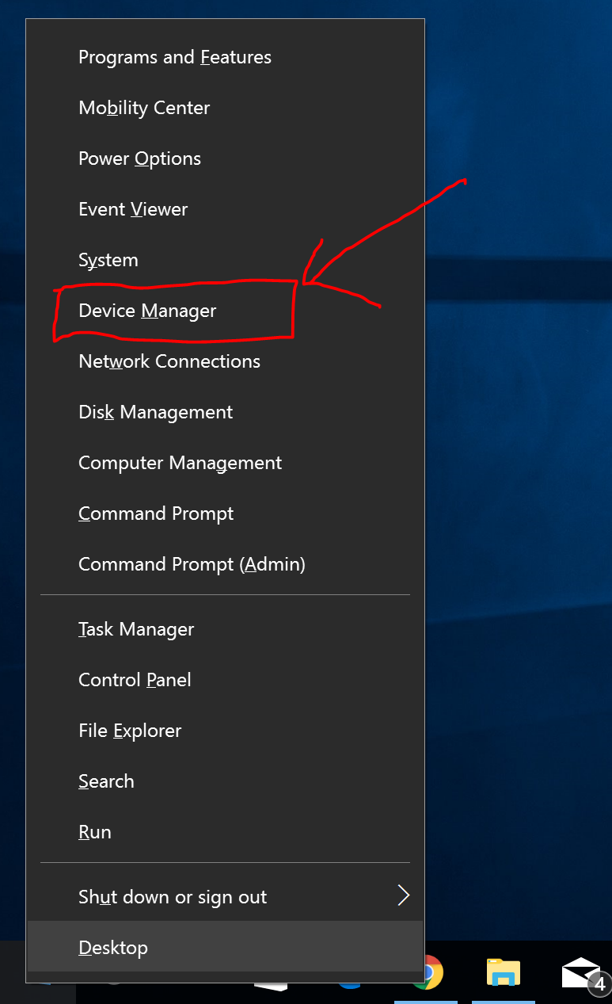
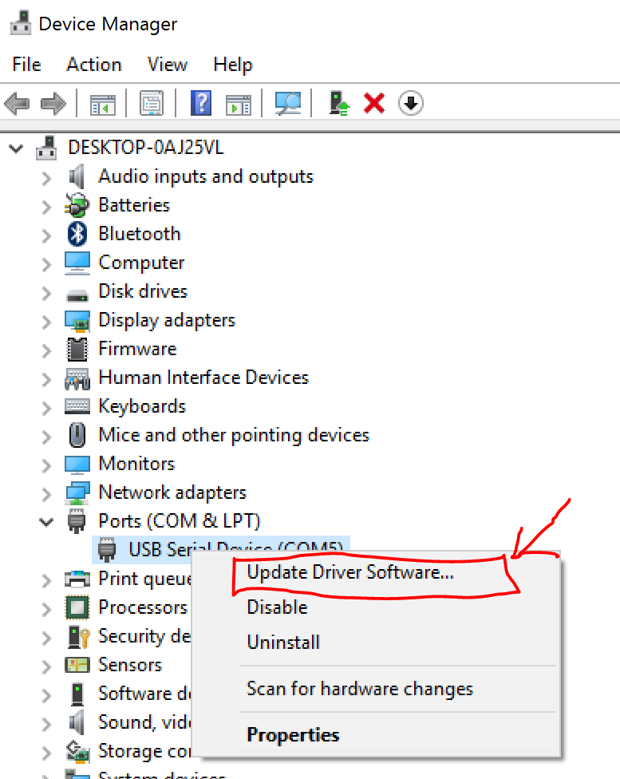
Step 2:
Connect the Arduino Pro Micro board to your laptop via a USB cable
Go to Device Manager
Under Ports (COM & LPT)
USB Serial Device (COM “”)
Right-Click on it and select “Update Driver Software…”

Slide 4
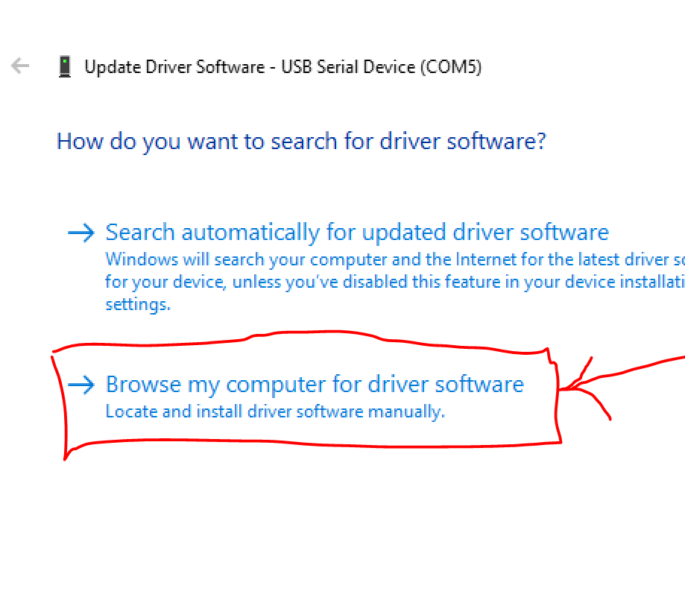
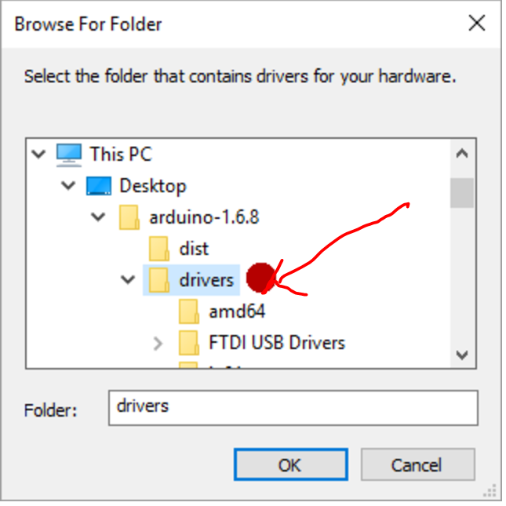
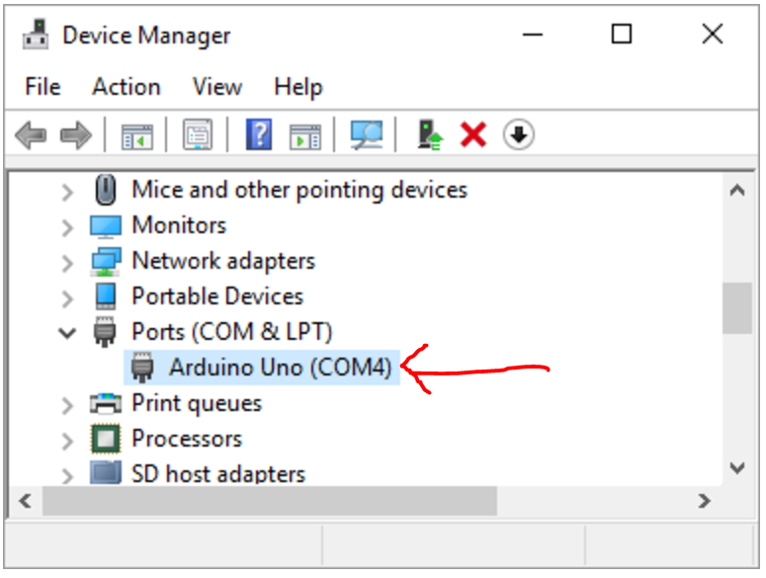
Step 3:
Select “Browse my computer for driver software”
Click on “Browse” and navigate to the drivers folder of your Arduino folder
Proceed on with the installation
Once it is completed, your COM port should be recognized as Arduino in the device Manager

Slide 5
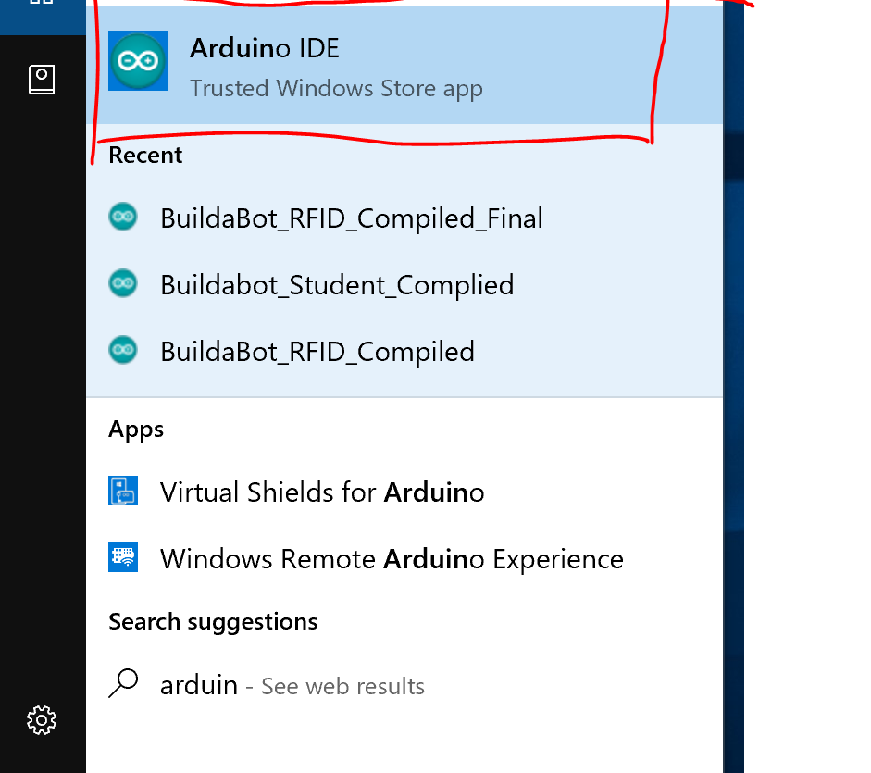
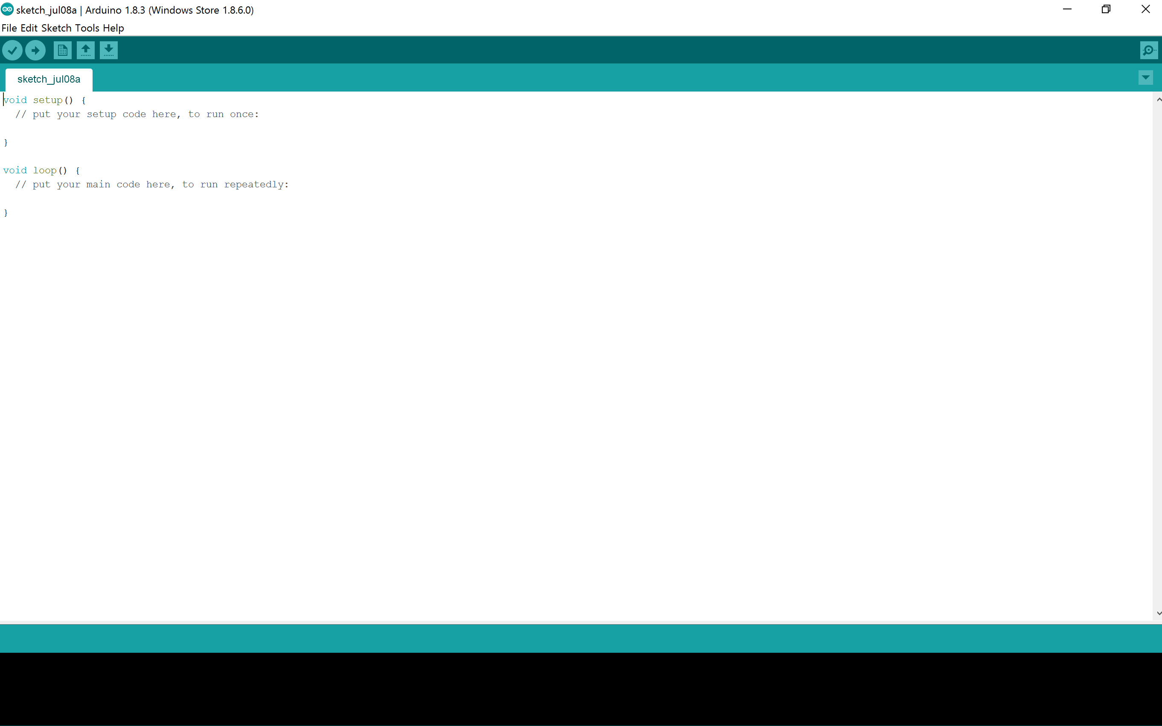
Step 4:
Open the Arduino IDE by clicking on the Arduino Icon (If you are unsure on where to find the icon, use your laptop search function)
The Arduino IDE platform should look like this

Slide 6
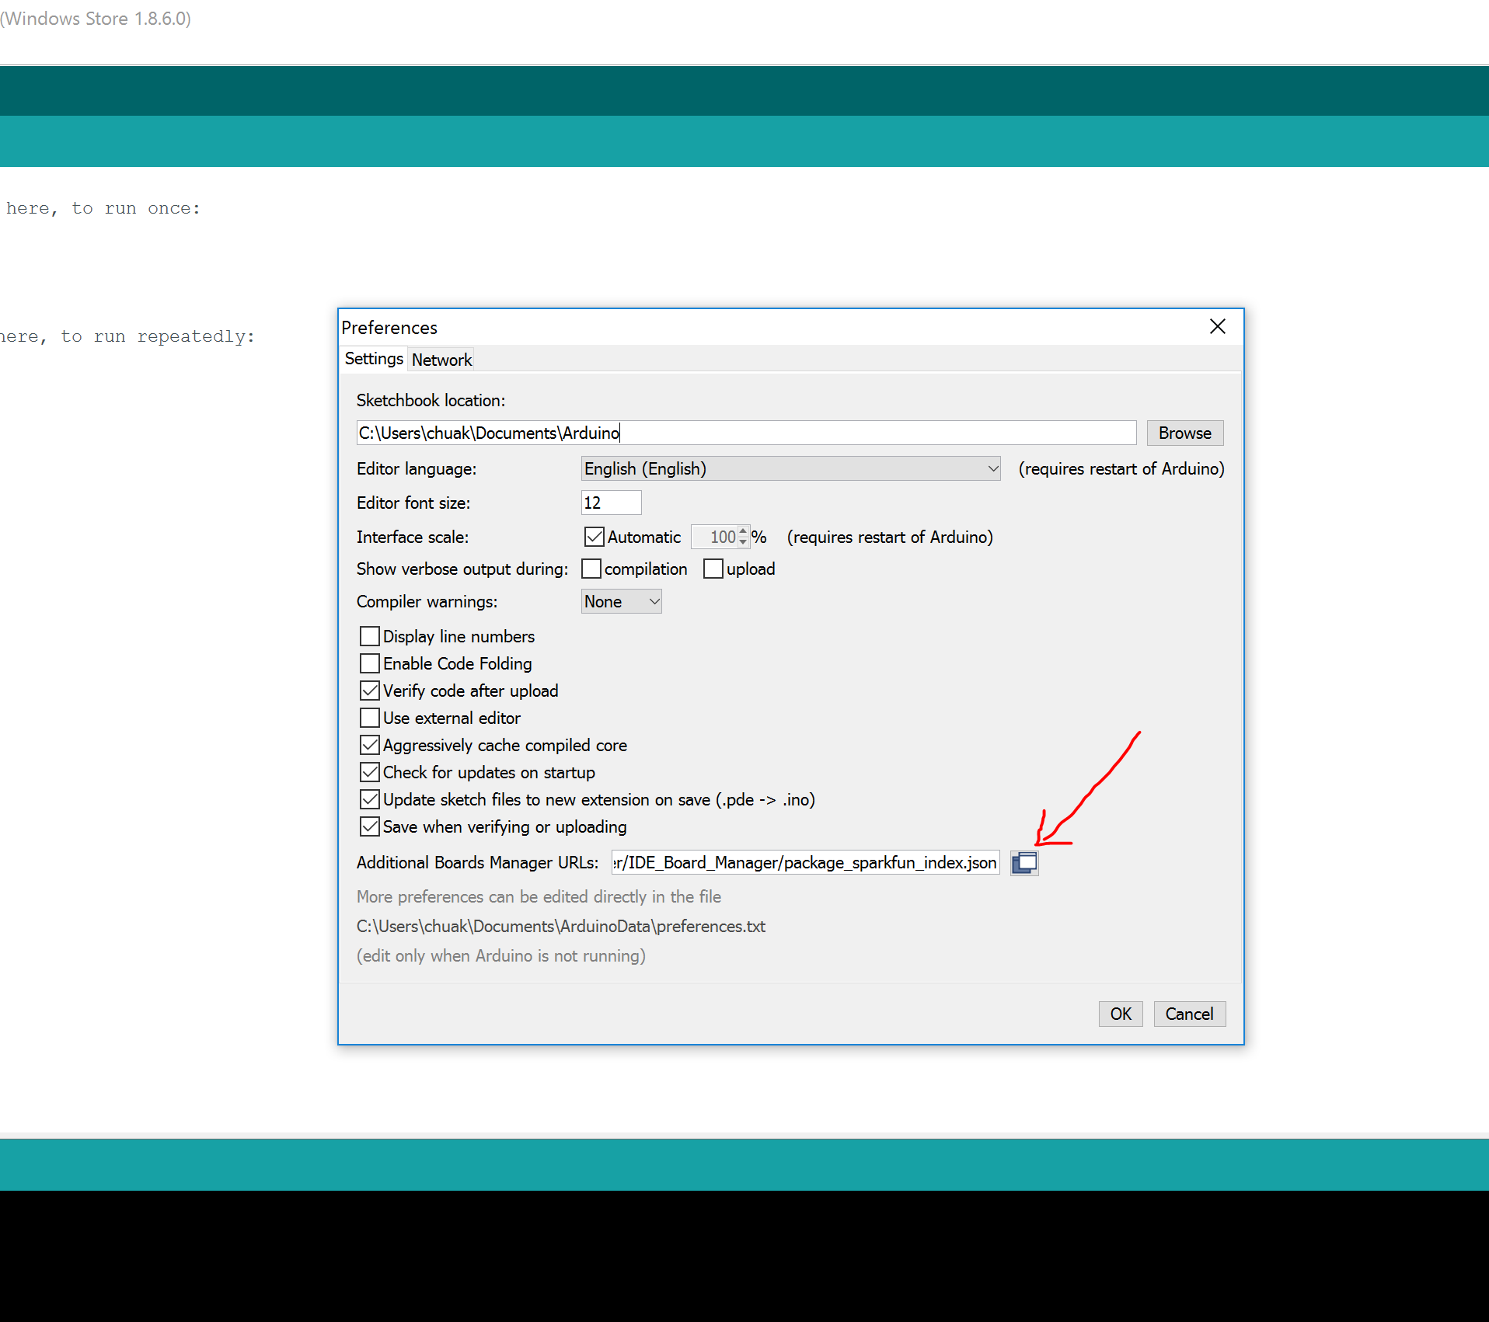
Step 5:
On the top left hand corner of the window, click on File>Preferences
Under “Additional Boards Manager URLs:”, replace the default url with
https://raw.githubusercontent.com/sparkfun/Arduino_Boards/master/IDE_Board_Manager/package_sparkfun_index.json

Slide 7
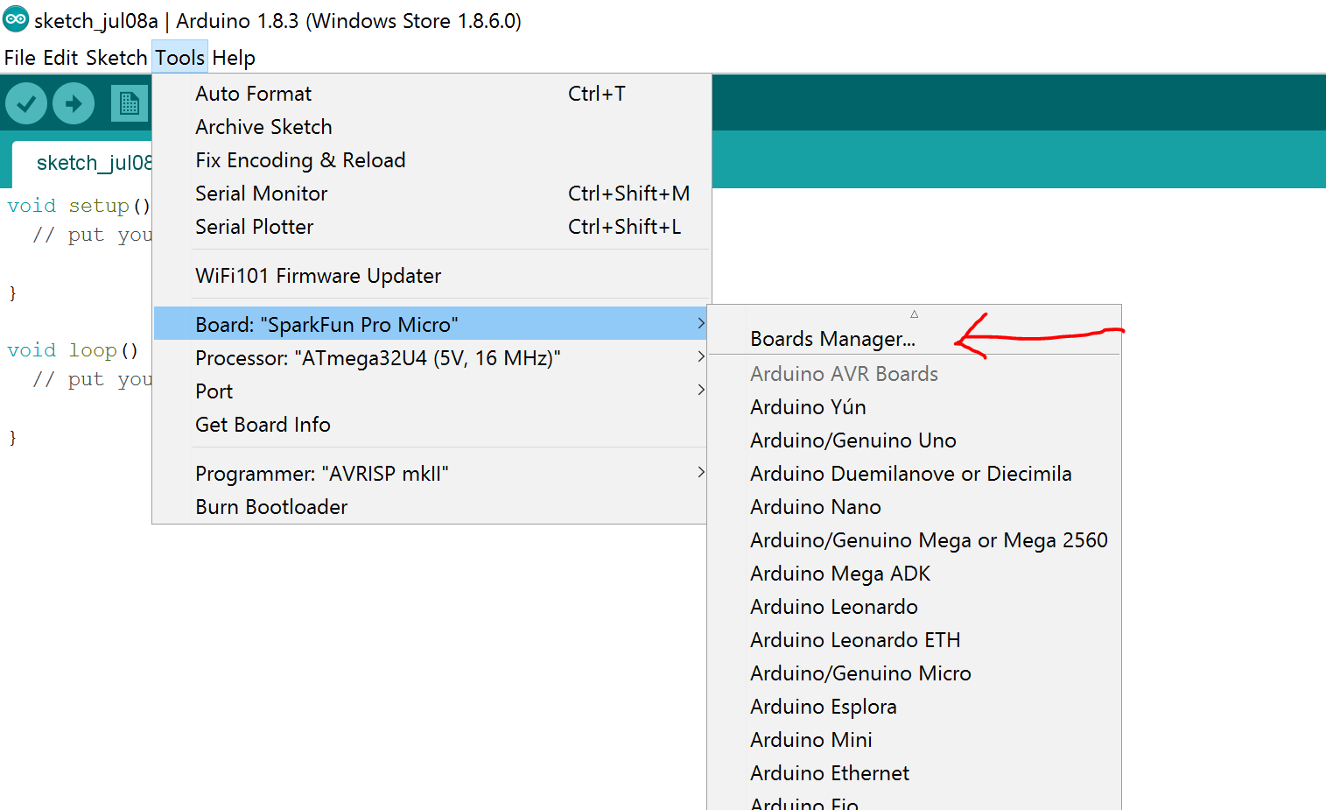
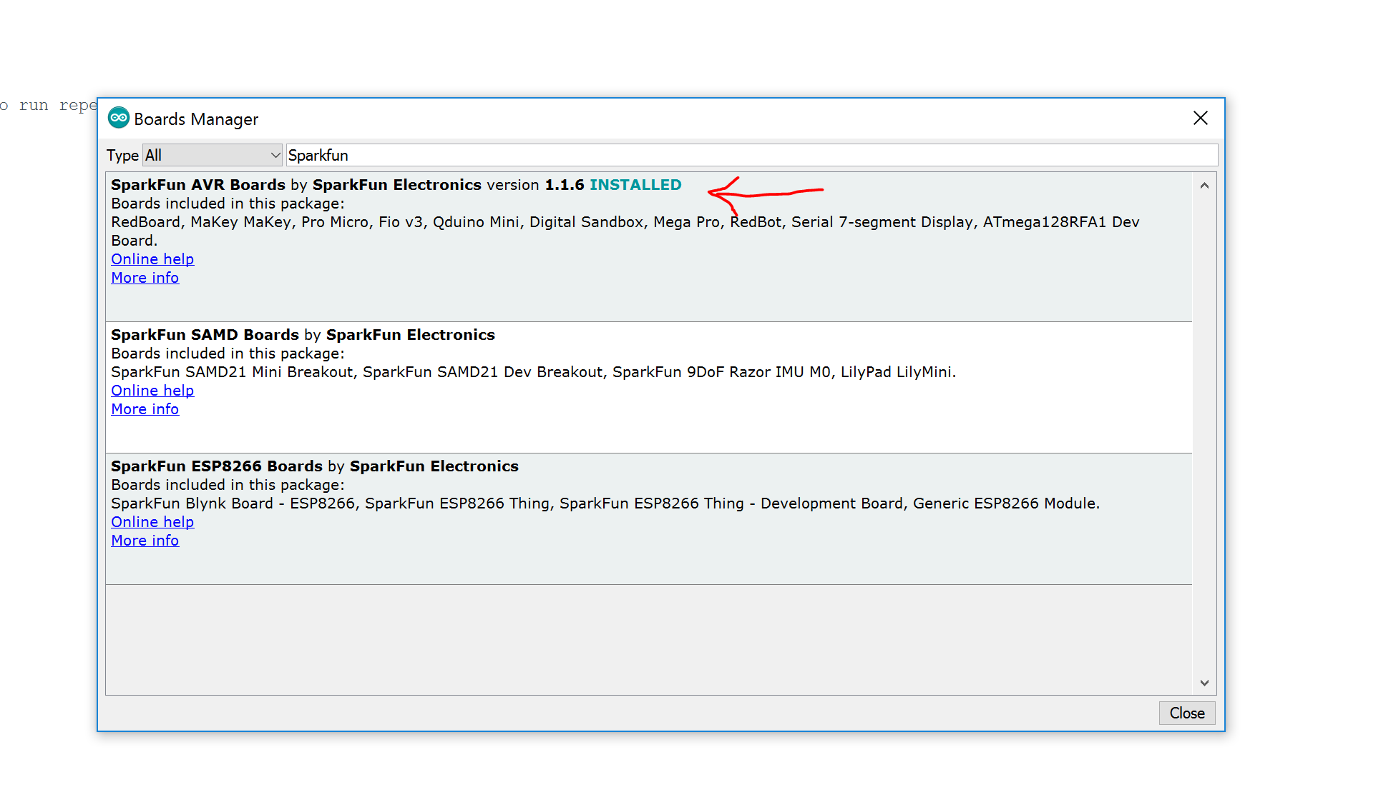
Step 6:
On the top left hand corner again, click on Tools>Board:””>Board Manager:…
In the Board Manager, search for “Sparkfun” and install the “SparkFun AVR Boards”

Slide 8
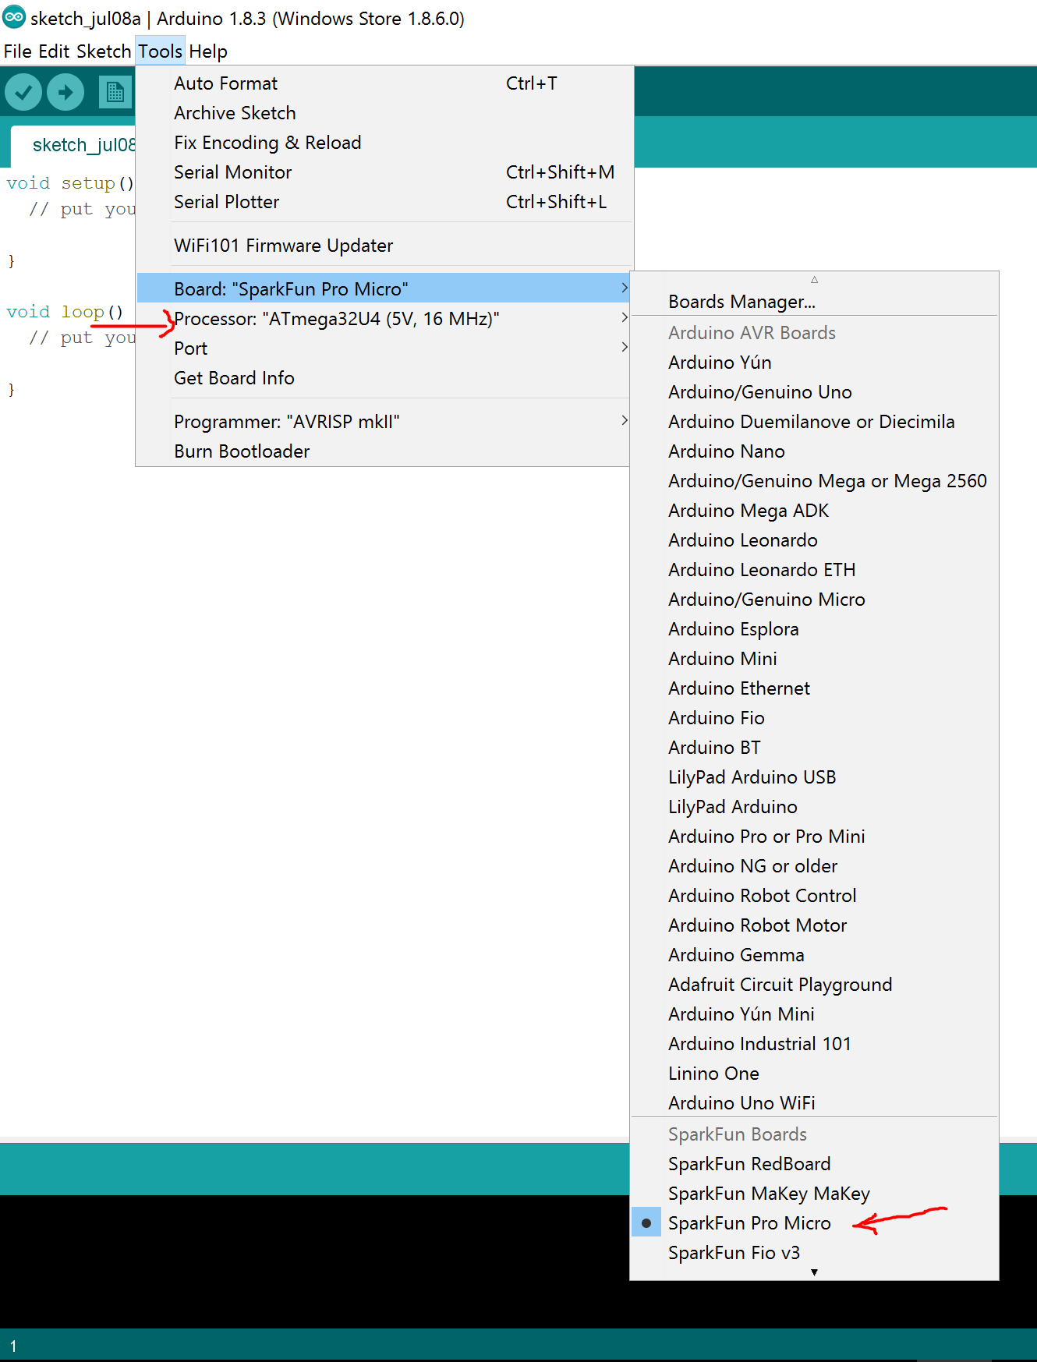
Step 7:
Once you are done with the installation, return to Tools>Board:”” and you should be able to select SparkFun Pro Micro as your Board
Under Processor:””, select ATmega32U4 (5V,16 Mhz)
Under Port, select the COM port that is recognized as Arduino. Note that this can only be done if your Arduino Pro Micro device is physically connected to your laptop via a USB cable

Slide 9
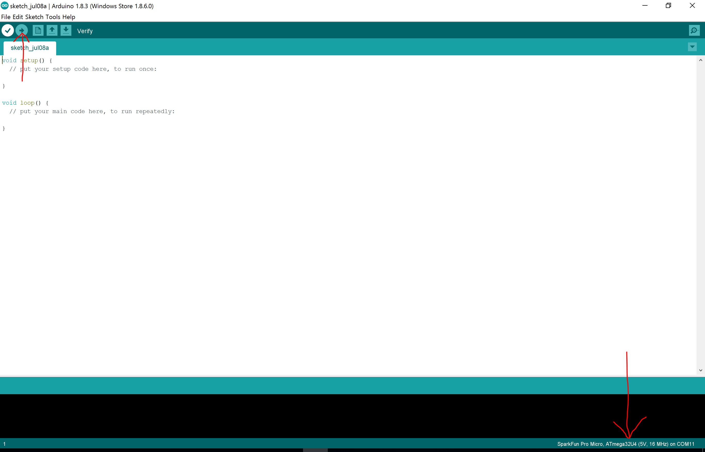
Step 8:
After your setup is done, try uploading a blank file by clicking on the upload icon located at the top left hand corner of the window
The Arduino should verify, compile and upload the blank program into your Arduino Pro Micro without any issues
If there is an issue, please refer to any of the lab helpers for help

